Slide 1
Examination Timetabling Automation using Hybrid Meta-heuristics Trabalho de projeto Ano letivo 2014/2015
Instituto superior de engenharia de lisboa
Mestrado em engenharia informática e computadores
Student: Miguel Nunes
Supervisors: Artur Ferreira 07/11
Nuno Leite

Slide 2
Summary
The Timetabling Problem
Existing Approaches
ITC2007 Examination Timetabling Problem
System Architecture
Loader and Solution Initialization
Proposed Approach: Local Search
Experimental Results
Conclusions

Slide 3
Goals of this project
Generation of timetables according to the ITC 2007 (International Timetable Competition) - examination timetabling track
Timetable Validator
Notes:
Explicar:
ITC2007
Gerador implementado (resumo)
Validator
Examination Timetable é explicado no slide seguinte
GUI é opcional

Slide 4
The Timetabling Problem (1/2)
Examination Timetabling
Course Timetabling
School Timetabling
Problem constraints can be hard or soft:
Hard constraints – set of rules which must be followed in order to obtain a feasible/valid solution
Soft constraints – set of non mandatory rules that if not followed, it adds a penalty to the solution
Notes:
Explicar:
Os 3 tipos de problemas
Os dois tipos de constraints

Slide 5
The Timetabling Problem (2/2)
Two possible formulations:
Search problem
Optimization problem
Possible types of solutions:
Feasible
Non feasible
Optimal
Sub-optimal
Notes:
Explicar:
Os dois tipos de formulações
A hipotese de fazer hibridação e que é o caso desta mesma approach
Todos os tipos de soluções

Slide 6
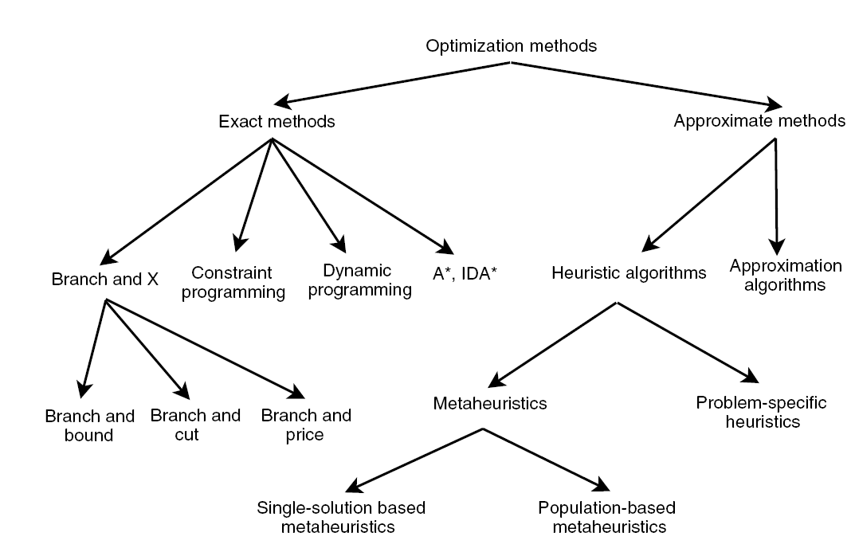
Existing Approaches
Exact algorithms
Graph Coloring Based techniques
Single-solution based meta-heuristics
Population based meta-heuristics
Notes:
Explicar:
O desenho
O facto de GCH pertencer a Problem-Specific Heuristics

Slide 7
Exact algorithms
Search the whole space of solutions
It is guaranteed that an optimal solution is found
Inappropriate for large sized problem instances
Algorithms
Branch-and-Bound
Constraint-Programming
Notes:
Explicar este tipo de algoritmo

Slide 8
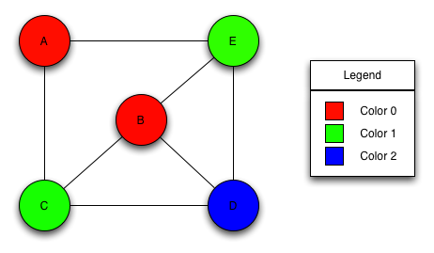
Graph Coloring Based techniques
Problem-specific heuristic
Assign the minimum set of colors to an element type of the graph following certain constraints
Examples of Graph Coloring problems:
Vertex Coloring
Edge Coloring
Timetabling problems can be reduced to a graph coloring problem
Notes:
Explicar:
O algoritmo
Que é um problem-specific heuristic (como dito na imagem)

Slide 9
Meta-heuristics
Provide solutions for optimization problems
Used in timetabling problems to optimize feasible solutions provided by heuristics
Sub-types:
Single-solution meta-heuristics
Population-based meta-heuristics
Notes:
Explicar:
Este tipo de heuristic
Os seus subtipos

Slide 10
ITC 2007 Examination timetabling problem (1/2)
12 different datasets
Ranking depends on the distance to feasibility and fitness values
The benchmarking program limited this project’s execution time to 225 seconds
Notes:
Explicar:
Este problema no geral (tem as suas próprias hard e soft constraints, objectivo é criar um horário final seguindo as regras de hard constraints….)
Que cada dataset tem diferentes dificuldades (detalhes sobre estes são dados no slide a seguir)
Explicar o benchmarking program
Hard constraints
The hard constraints are the following:
No student must be in more than 1 exam at the same time
Room’s capacity must not be exceeded
Exam’s length must not surpass the assigned time slot’s length
Exams hard constraints must be followed (e.g., 1 AFTER 2)
Rooms hard constraints must be followed (e.g., 1 ROOM_EXCLUSIVE)

Slide 11
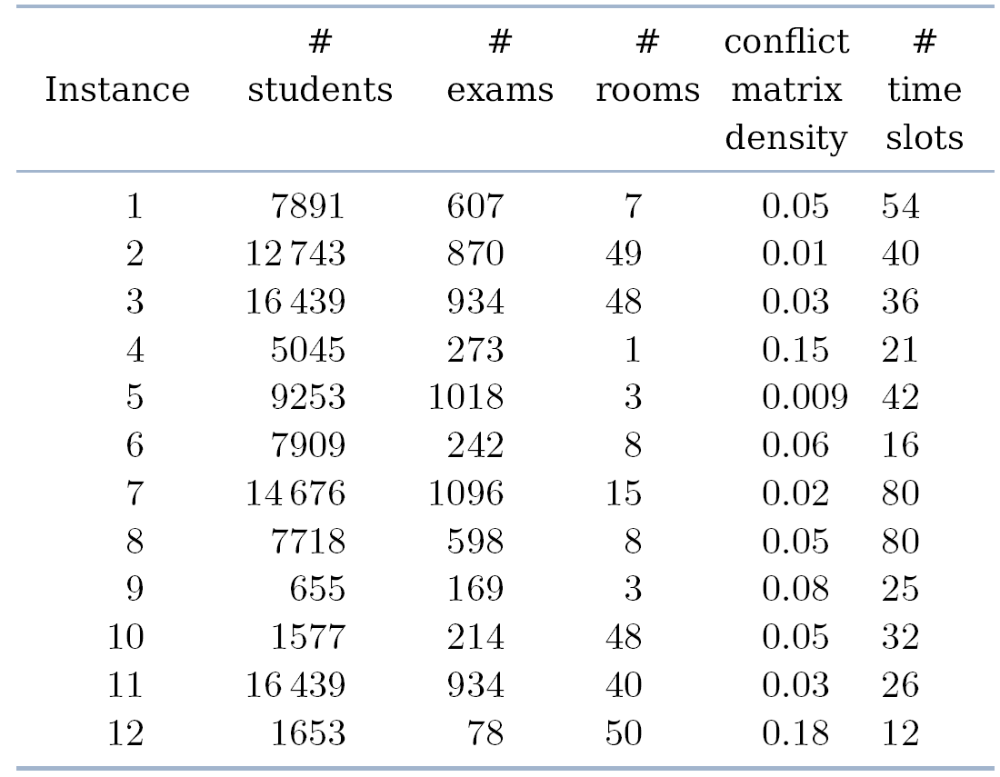
ITC 2007 Examination timetabling problem (2/2)
Notes:
Explicar o porquê de cada dataset ter a sua dificuldade e demonstrar exemplos

Slide 12
ITC 2007 Examination timetabling problem (3/3)
The soft constraints are the following:
Two exams in a row or in a day
Period spread
Mixed durations
Larger exams constraints
Room penalty
Period penalty
Notes:
Explicar cada um dos soft constraints

Slide 13
Proposed Solution
Graph Coloring
Simulated Annealing
Hill Climbing
Examination Timetable
ITC 2007 Data
Loader

Slide 14
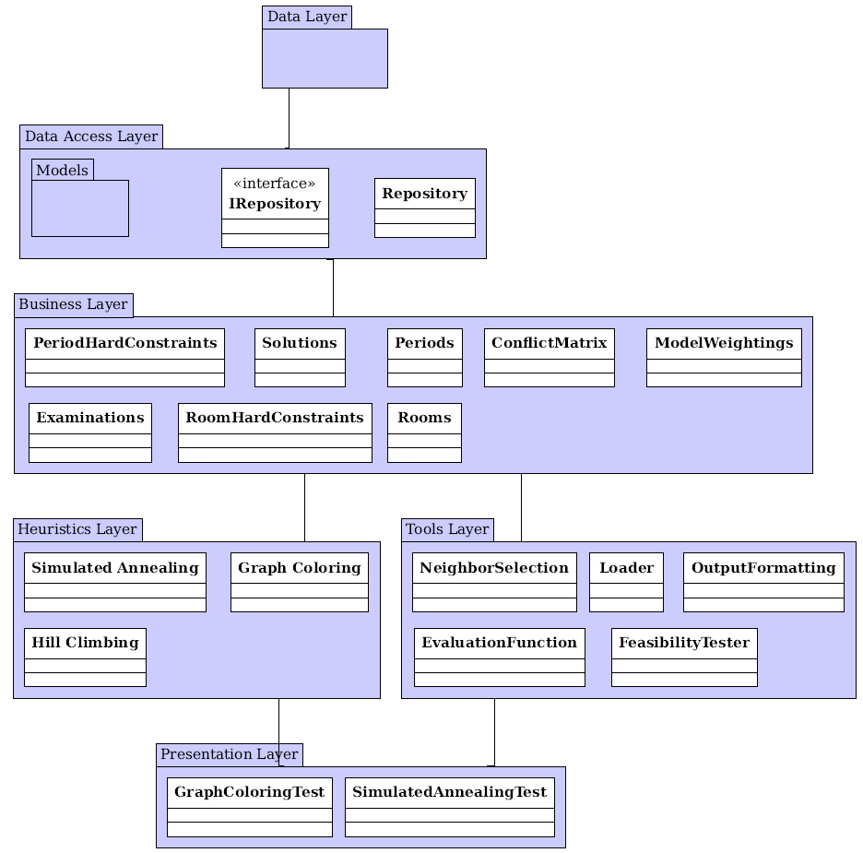
Proposed Architecture
Data Layer
Stores all entities
Data Access Layer
Provides repositories to access the stored entities
Business Layer
Provides functionalities to manipulate the repositories
All business classes implement the Singleton pattern
Heuristics Layer
Provides access to the implemented heuristics
Tools Layer
Tools used by the Heuristics Layer and lower layers
Presentation Layer
Notes:
Explicar cada camada separadamente e as suas ligações

Slide 15
Loader
First phase on the project execution
Loads all the information from the dataset
Creates and populates the conflict matrix
Each dataset contains all the information required to create a solution:
Examinations and students’ attendings
Rooms, their capacities and penalties
Periods and their penalties
Period and room hard constraints (optional)
Soft constraints
Notes:
Explicar:
Esta tool
O que está presente nos ficheiros dos datasets
Conflict Matrix

Slide 16
Graph Coloring
Largest Degree Ordering method is used
Generates a feasible solution
Implementation:
Populates and sort the assignment lists:
Unassigned examinations with room exclusivity hard constraint
Unassigned examinations with after hard constraint
Unassigned examinations with examination coincidence hard constraint
All other unassigned examinations
Examination assignment.
Normal assignment
Forcing assignment
230
110
422
75
621
954
13
755
18:04:2005
E: 107 R: 2
E: 202 R: 1
19:04:2005
E: 2 R: 5
20:04:2005
E: 112 R: 6
E: 254 R: 1
Notes:
Explicar:
Primeira heuristica a ser executada
Explicar LDO
Cada fase (com a ajuda da imagem)

Slide 17
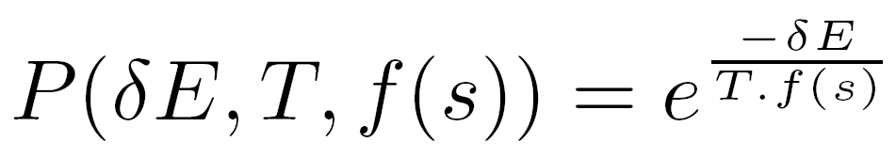
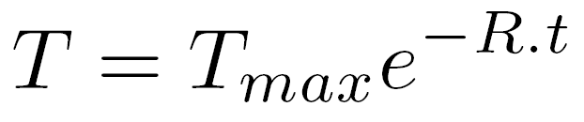
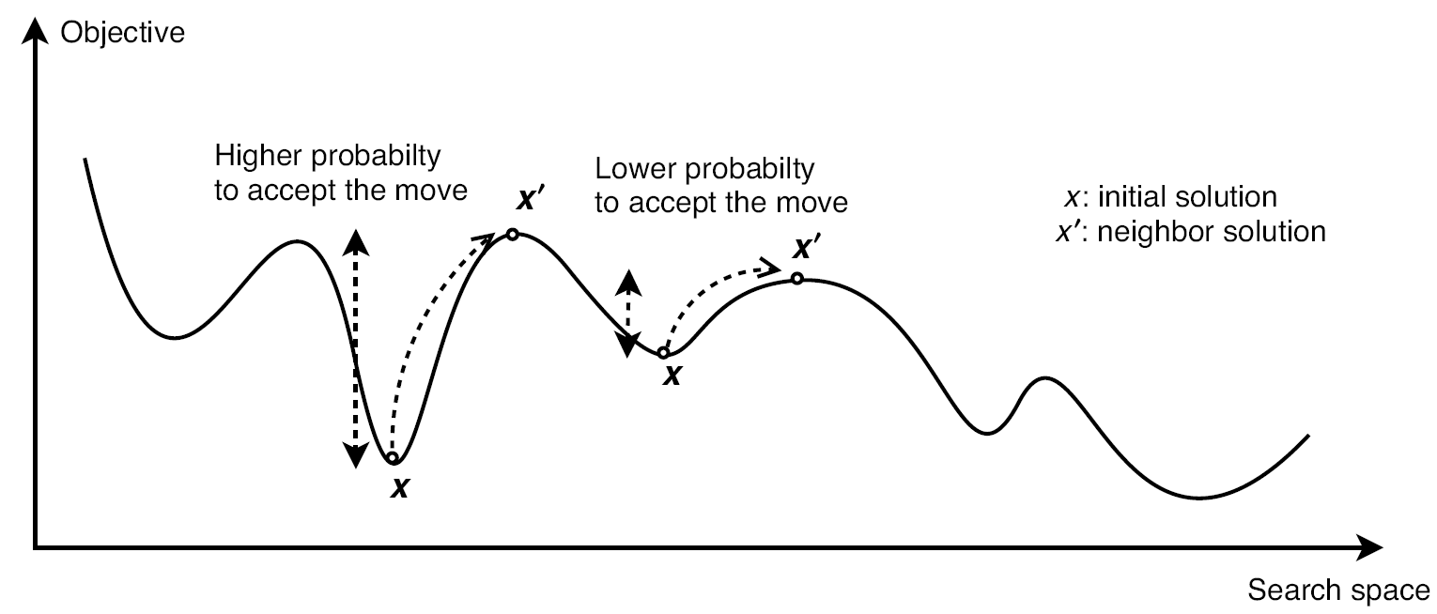
Simulated Annealing (1/2)
Neighbor operators generate neighbor solutions
Neighbor solutions’ acceptance criterion:
Exponential (decreasing) cooling schedule:
Parameters used in this meta-heuristic:
Maximum temperature
Minimum temperature
Number of iterations per temperature value
Temperature decreasing rate
Notes:
Explicar:
Esta heuristic
O que é acceptance criterion
Cooling schedule
Todos os parametros (com ajuda da imagem)

Slide 18
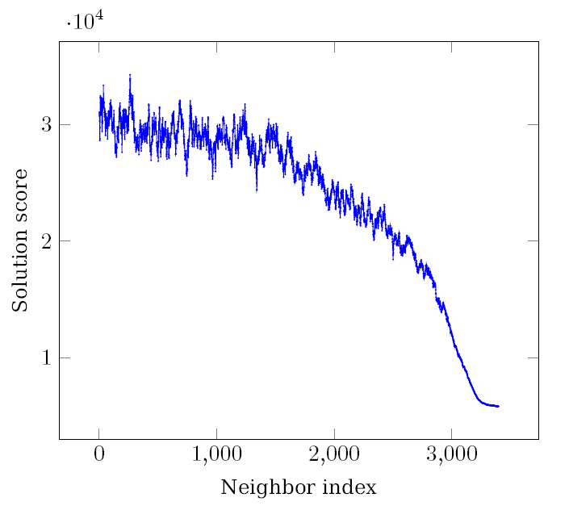
Simulated Annealing (2/2)
Parameters : TMax = 0.1, TMin = 1e-06, loops = 5 and rate = 16e-5
Results:
Notes:
Explicar o porquê deste resultado

Slide 19
Hill Climbing
Uses the same neighbor operators as the SA
Only accepts better solutions
It is time-monitored
Guarantees that the computation is finished within the given time limit
Notes:
Explicar:
A heuristica
O porquê da utilização desta heuristica

Slide 20
Neighborhood Operators
The implemented neighborhood operators:
Room Change
Period Change
Period & Room Change
Room Swap
Period Swap
Period & Room Swap
Notes:
Explicar:
Cada operador
Que a escolha é random e que foi implementado outro guiado mas que normalmente tem piores resultados
O ultimo operador foi implementado mas não foi usado – Explicar os testes feitos

Slide 21
Fitness computation
Great influence in the algorithm performance;
Fitness is computed incrementally:
Takes advantage of the similarities between the solution and the generated neighbors;
Results are obtained 19 times faster;
Solution space is explored with more detail.

Slide 22
Rate computation (Simulated Annealing)
The computation requires a simulation of the SA algorithm;
A new rate is computed for each set:
SA runs as close as possible to the given time limit;
SA execution time becomes independent of the set’s difficulty;
Higher likelihood of obtaining better results.

Slide 23
Experimental Results (1/2)
The results were obtained by averaging 10 runs for each dataset
The SA parameters were:
TMax = 0.1
TMin = 1e-06
reps = 5
rate = computed automatically

Slide 24
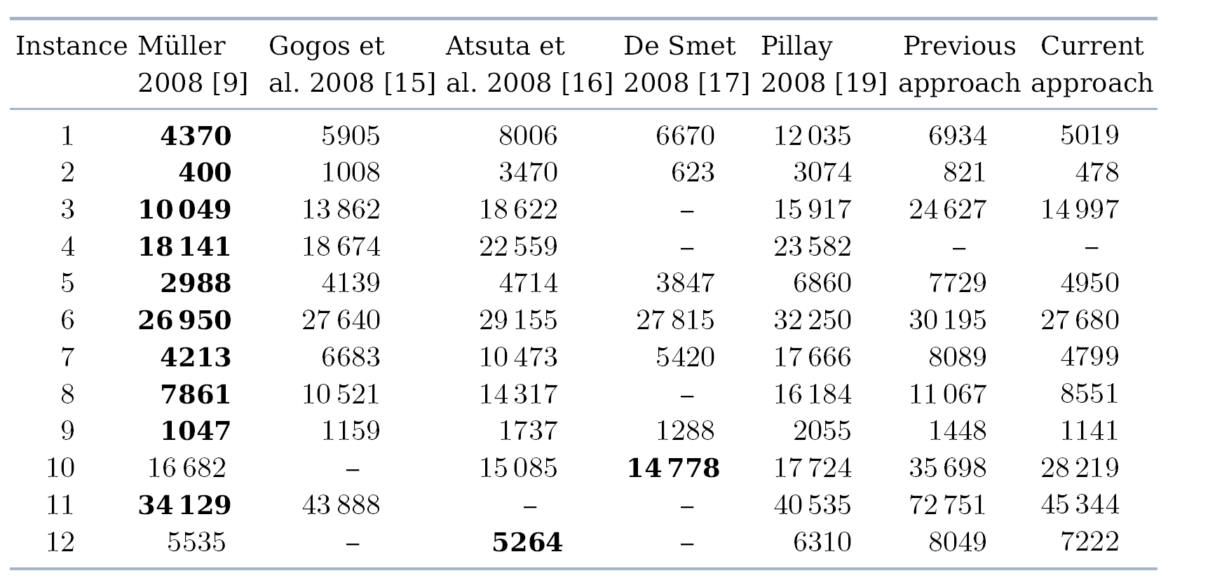
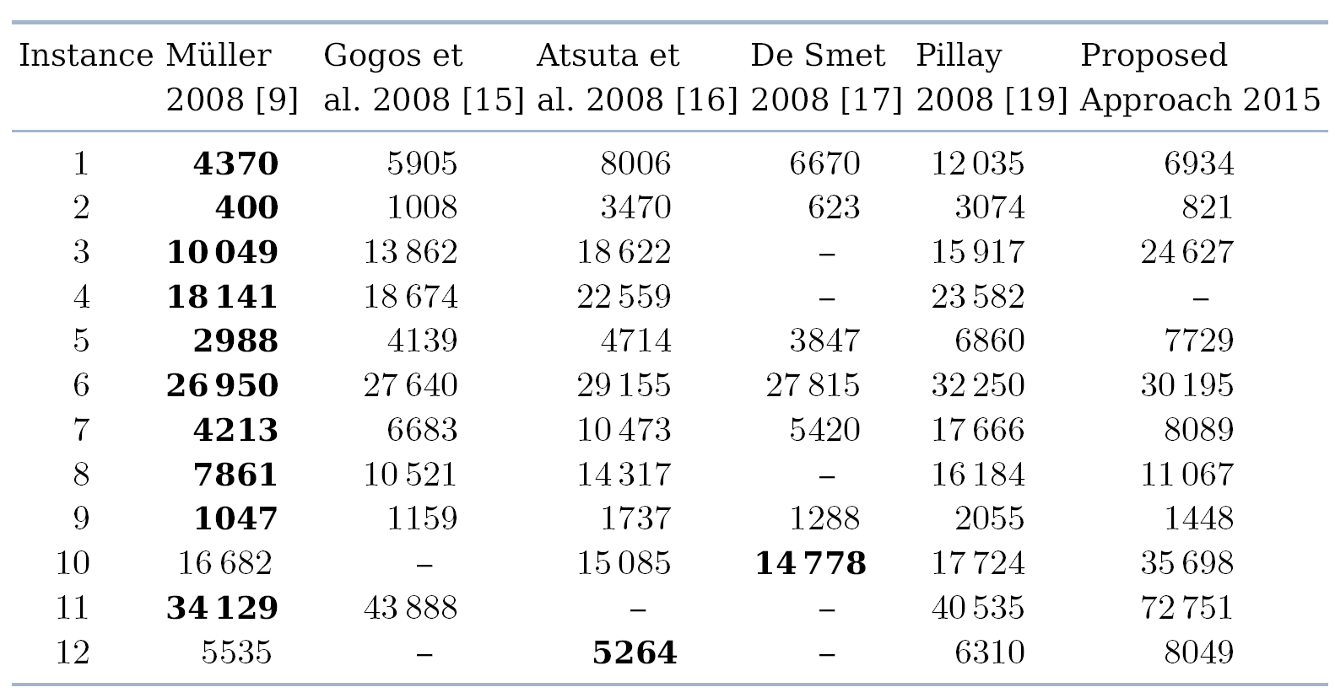
Experimental Results (2/2)
Notes:
Explicar que foi possível em alguns datasets obter resultados que são comparaveis aos 5 vencedores

Slide 25
Conclusions
A program was developed to generate timetables following ITC2007 rules, using heuristics:
Graph Coloring heuristic was developed to obtained a feasible solution
Simulated Annealing and Hill Climbing meta-heuristics were developed to improve the initial feasible solution

Slide 26
Tools and Techniques
Developed using .NET
C# Programming Language
Visual Studio 2013 was used as the development tool
The Resharper extension was also used

Slide 27
Ongoing Work
Project’s progress is about 70%
The remainder will be carried out for the final phase:
Performance improvement of the existing features
Implementation of a new approach using a Genetic Algorithm
Comparison against the five ITC2007 winners and with the previous approach
Implementation of a GUI to demonstrate the final solution (optional)
Notes:
Explicar o que é suposto melhorar, e que isto está de momento em desenvolvimento.
Melhorias já foram feitas desde que estes testes foram efectuados e já se verificaram melhorias significativas.
Mas o melhoramento não está ainda todo implementado, e quando estiver, os resultados vão sofrer melhorias ainda mais significativas!
Explicar também que um genetic algorithm é um population based meta-heuristic, etc.

Slide 28
The End
I hope you have enjoyed it!
Any questions?

